Slide 1
2021-2022 Verification & COVID-19
Lindsey Barta, Director of Financial Aid Operations, Inceptia

Slide 2
Overview
Verification requirements and COVID-19 flexibilities
Electronic Announcement VERIF-21-01
NASFAA’s Tax Transcript Decoder
Unique situations
Questions

Slide 3
Verification Resources
Federal Register
Published September 3, 2020
Outlines information to be verified for the 2021-2022 award year
No changes to Verification Tracking Groups or required verifiable items
https://ifap.ed.gov/federal-registers/FR090320
Online Training Course – 2021-22 Verification (Federal Student Aid E-Training)
Dear Colleague Letter ANN-21-01
https://ifap.ed.gov/dear-colleague-letters/ANN2101
2021-2022 FAFSA Verification-IRS Tax Return Transcript Matrix
Electronic Announcement 2020-11-20
https://ifap.ed.gov/electronic-announcements/112020FAFSAVerification2122IRSTaxReturnTranscriptMatrix

Slide 4
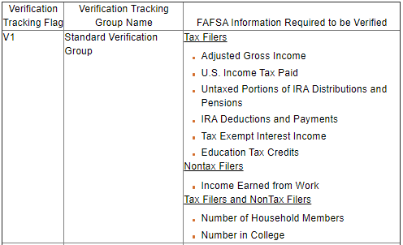
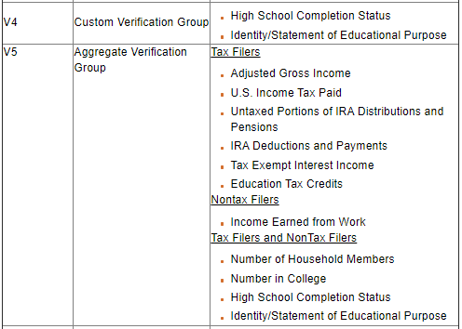
FAFSA Information Required to be Verified

Slide 5
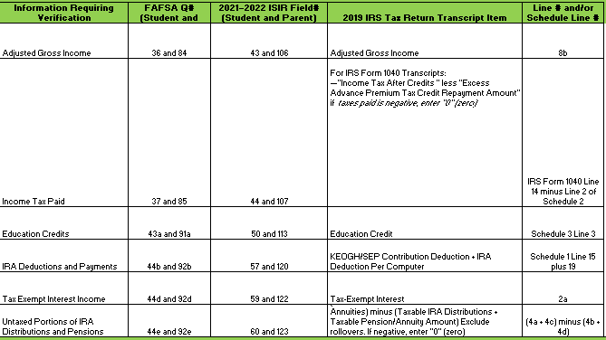
Acceptable Documentation for Tax-Filers
Unaltered information transferred by IRS Data Retrieval Tool (IRS request flag = 02)
IRS Tax Return Transcript
Signed copy of tax return and applicable schedules

Slide 6
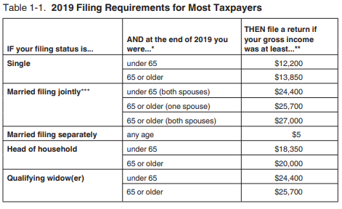
2019 IRS Tax Filing Thresholds

Slide 7
Acceptable Documentation for Non-Filers
Statement signed by the non-filing individual certifying:
That the individual has not filed and is not required to file a tax return
Each source of income earned from work
The amount of income earned from each source
Copy of IRS Form W-2 for each source of employment income reported
IRS Verification of Nonfiling Letter dated on or after October 1, 2020
Individual can request using “Get Transcript Online” tool on www.irs.gov or by submitting IRS Form 4506-T
Required for each person subject to verification who did not file (except dependent students)

Slide 8
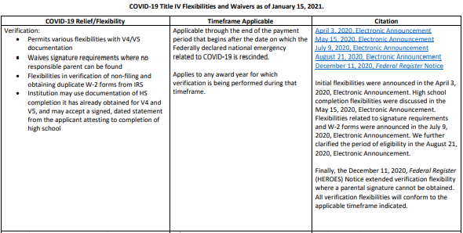
COVID Flexibilities

Slide 9
Electronic Announcement VERIF-21-01: IRS Data Retrieval Tool and Inaccurate $1 AGI
Related to individuals claiming the Economic Impact Payment (stimulus checks) or Recovery Rebate Credit
IRS Non-Filers: Enter Payment Info Here Tool recorded taxpayer’s AGI as $1
https://ifap.ed.gov/electronic-announcements/030521IRSDataRetrievalToolandInaccurate1AGI

Slide 10
Erroneous $1 AGI Scenario 1—Tax Filers
Student and/or parent used IRS DRT (“02” flag)
IRS DRT transferred in all zeroes and AGI of $1, but income from work reported
Tax Return Transcript also has all zeroes and AGI of $1
Collect signed copy of IRS Form 1040 and Schedules 1 and/or 3, if applicable

Slide 11
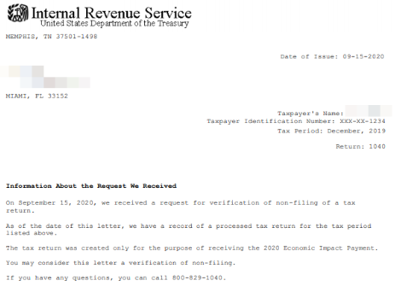
Erroneous $1 AGI Scenario 2 – Nontax Filers
Individual indicates they did not and were not required to file 2019 tax return
When VNF requested, IRS provided a transcript with $1 AGI instead
Collect IRS Letter 3538
Should be verified as nontax filer

Slide 12
Erroneous $1 AGI Scenario 3—Tax Filers who Filed Solely to Claim the Recovery Rebate Credit
Individual was not otherwise required to file a tax return
Filed a “simplified tax return” for 2019 with $1 of interest income, $1 of total income and $1 AGI
Should be verified as tax filer

Slide 13
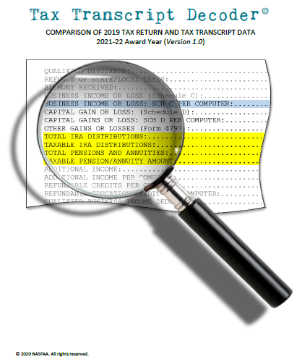
NASFAA’s Tax Transcript Decoder
https://www.nasfaa.org/uploads/documents/2021-22_Tax_Transcript_Decoder.pdf

Slide 14
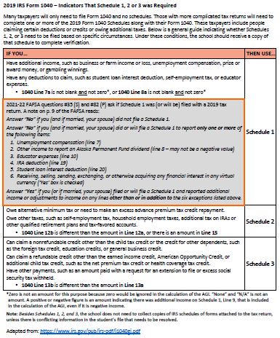
NASFAA’s Tax Transcript Decoder – Tax Schedules (page 26)

Slide 15
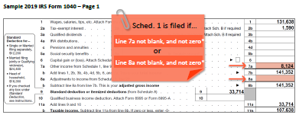
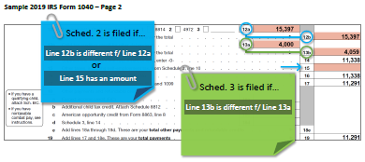
Schedule Indicators

Slide 16
Scenario
Samuel is an independent student. He indicates on his 2021-2022 FAFSA that he is married as of June 2020. Upon being selected for verification, Samuel’s school requests his and his spouse’s 2019 tax information.
Samuel submits a 2019 IRS Tax Return Transcript that shows he filed single with an AGI of $45,852 and income tax paid of $3,817. His wife, Ruby, submits a signed copy of 2019 IRS Form 1040 that was filed jointly with her ex-spouse, Daniel. The 1040 shows an AGI of $29,461 and income tax paid of $0.
What additional documentation would be needed to complete income verification for Samuel?
How would you determine what amounts to report for AGI and income tax paid on the FAFSA?

Slide 17
QUESTIONS?

