Slide 1
Welcome to NeASFAA
Nebraska Association of Student Financial Aid Professionals
Notes:
Name
Institution/Company
How long have you been in FA
If you completed an NCAA March Madness bracket, who did you pick to win the Championship?

Slide 2
Mission Statement
The Nebraska Association of Student Financial Aid Administrators (NeASFAA) exists primarily to promote the professional preparation, effectiveness and mutual support of persons involved in student financial aid administration. In addition, NeASFAA exists to bring about the implementation of programs that will have a positive impact on students' ability to pay for programs of higher education.
In order to effectively serve the needs of its members, NeASFAA shall strive to serve in a leadership role within the National Association of Student Financial Aid Administrators (NASFAA).
The Association shall serve as a forum for its members and act as a focus for the expression of views on matters relating to the development, funding and administration of student financial aid.
While the Association's primary goal is to provide an avenue for preparation to those members who are directly responsible for the administration of student aid programs, NeASFAA shall strive to expand its training services to include other individuals who play a major role in assisting students in completing and paying for programs of higher education.
In order to effectively meet the goals of its mission and the diverse and changing needs of the post-secondary education community, NeASFAA seeks to maintain a spirit of cooperation and an approach which is flexible, equitable and innovative.

Slide 3
Purpose
NeASFAA exists to:
develop professionalism among aid officers of Nebraska
provide a means to bring together aid officers for the discussion of common problems
influence federal and state legislation dealing with student financial aid programs and to provide an avenue for dissemination of ideas and concerns of students and administrators in financial aid problems
provide training for newly appointed aid officers
assist secondary school counselors in their work with students in planning their future by providing timely and updated information concerning financial aid
provide a means of affiliation with the Rocky Mountain Association of Student Financial Aid Administrators (RMASFAA) and the National Association of Student Financial Aid Administrators (NASFAA).
Notes:
NeASFAA’s president Beth Sisk serves as the state delegate to the RMASFAA Board.
RMASFAA’s president Joe Donlay serves as the region’s delegate to the NASFAA Board.

Slide 4
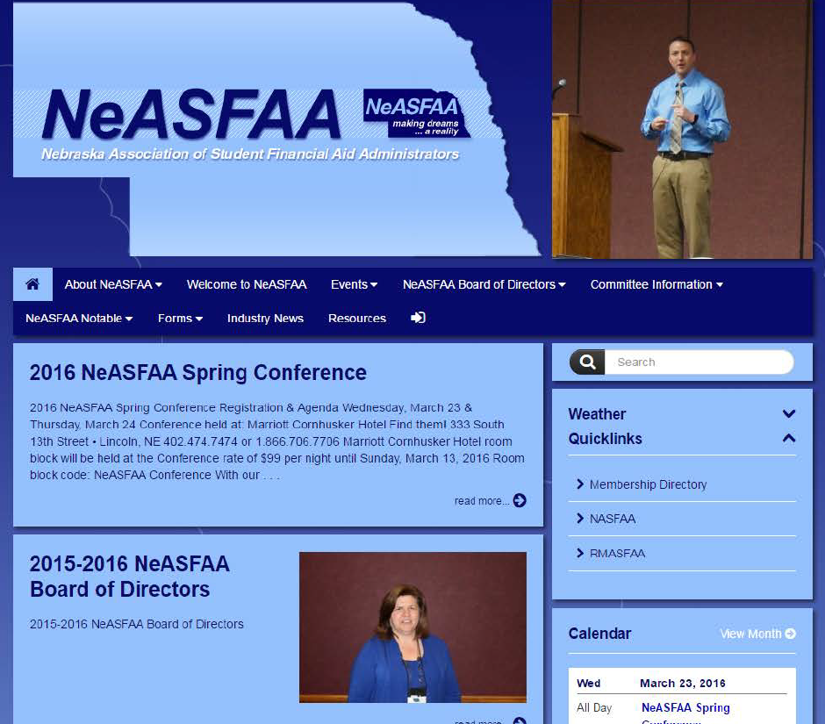
NeASFAA.org
Notes:
Board of Directors – NeASFAA Board of Directors, Board. Ever wonder who is President of NeASFAA or who is your school’s sector rep?
Committee Information – this will include a description of each committee, committee chair and members.
Conference Presentations – Events, Spring 2016 Conference. You will find a copy of the Conference presentations
Welcome to NeASFAA – information such as history, mission, purpose, membership directory login info

Slide 5
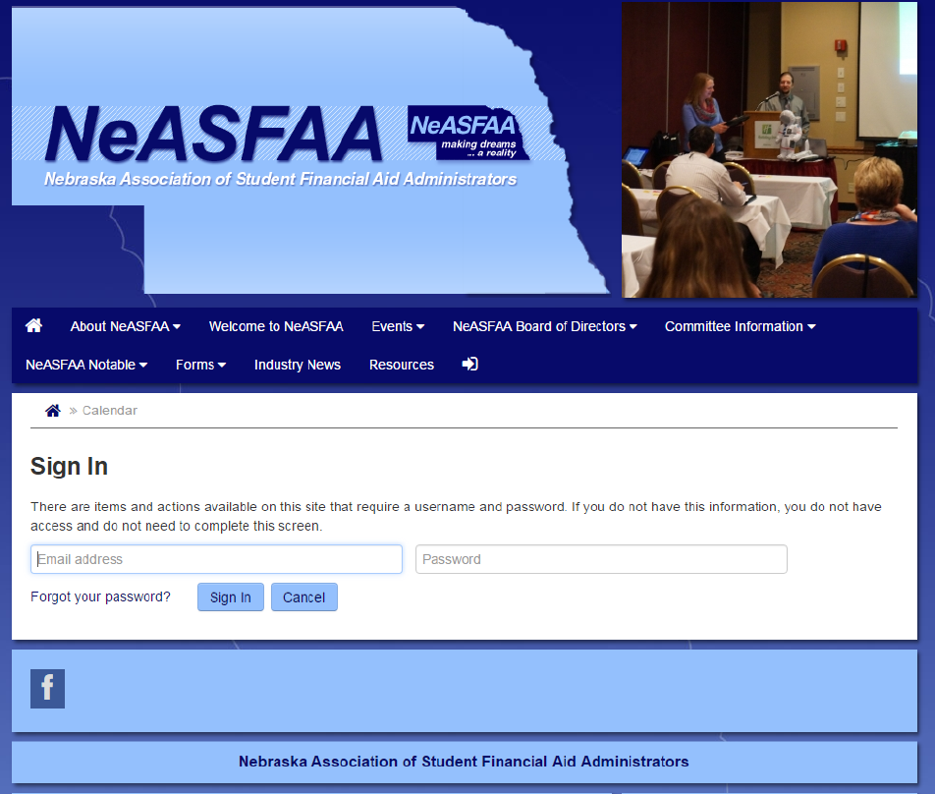
NeASFAA.org
Membership Directory
Login: member@neasfaa.org
Password: nebraska
Notes:
This is the only section of the website that is password protected. You will not need an individual login/password to access any other section of the website.

Slide 6
NeASFAA Board of Directors
Elections held each fall
  Each College/University has an assigned voting member
1 year term: President, President-elect, Past president and Secretary
2 year term: Treasurer and all Sector Representatives
New Board members are installed at the end of each spring conference
Board meets 3-4 times per year
Committee chairs/co-chairs attend BOD meetings, but do not vote
Notes:
Elections are typically held in late fall/early winter
Voting members are listed on the “institution” pdf listing of the Membership Directory.
Voting members will vote on NeASFAA president, president-elect, Secretary, Treasurer and their Sector Rep. Voting member also vote on items that require a vote of the Association such as changes to the NeASFAA Bylaws.

Slide 7
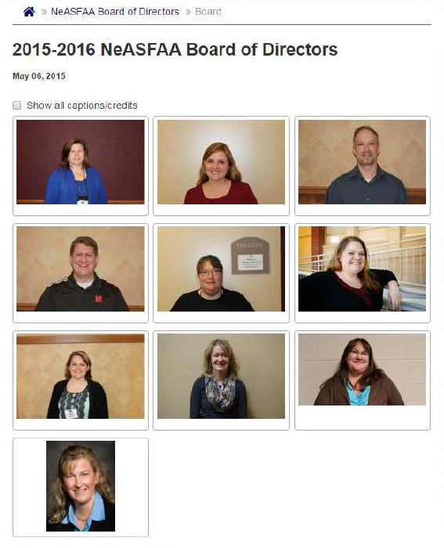
NeASFAA
Notes:
Here are the 15-16 BOD members, but the 16-17 members are listed on your handout.
President, Kay Dinkelman, UNL
President elect, Beth Sisk, CSM
Past president, Matt Johnson, UNK
Treasurer, Marty Habrock, UNO
Secretary, Stacy Dieckman, NE CC
4 yr public sector rep, Becca Dobry, UNK
4 year private sector rep, Wendy Mutulka, Concorida
2 yr public sector rep, Sheila Johns, Western NE CC
Private and career sector rep, Heather Kester, Kaplin – Lincoln
Associate sector rep, Stacy Seim, EducationQuest

Slide 8
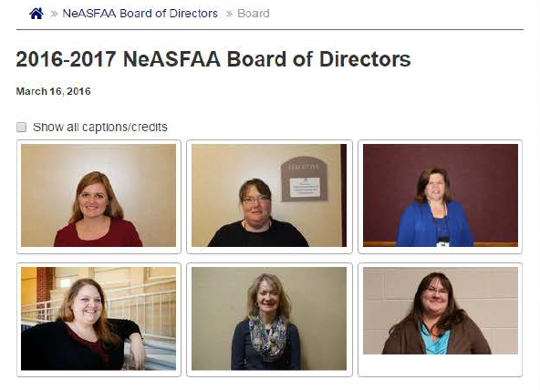
NeASFAA
Notes:
2016-2017 BOD
President, Beth Sisk, CSM
President elect, Stacy Dieckman, NE CC
Past President, Kay Dinkelman, UNL
Treasurer, Janice Volker, UNO (not pictured)
Secretary, Angie Pinkerman, Hastings College (not pictured)
4 yr public sector rep, Becca Dobry, UNK
4 year private sector rep, Taryn Rouse, Union College (not pictured)
2 yr public sector rep, Sheila Johns, Western NE CC
Private and career sector rep, Heather Kester, Kaplin – Lincoln
Associate sector rep, Kent Wolfe, Inceptia (not pictured)

Slide 9
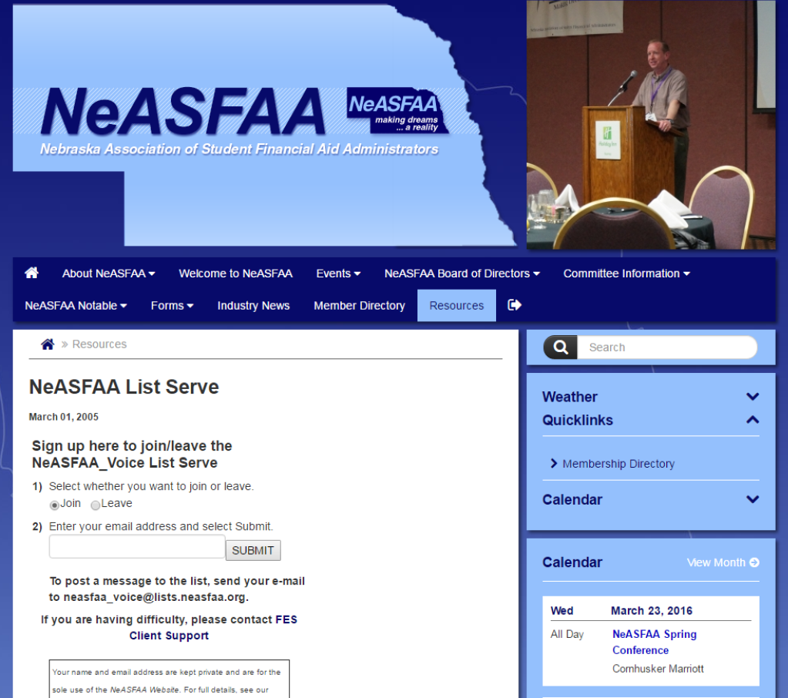
NeASFAA.org
NeASFAA List Serve
Allows you to email all NeASFAA members
Uses
  Ask a question
  Post an open position at your Institution
  Notice of training
Notes:
List Serve is under the “Resources” section
As a NeASFAA member you are already subscribed to the list serve. If your email changes, you will want to leave the list with your old email and join with your new email.
We ask that you not use the list serve for solicitation purposes

Slide 10
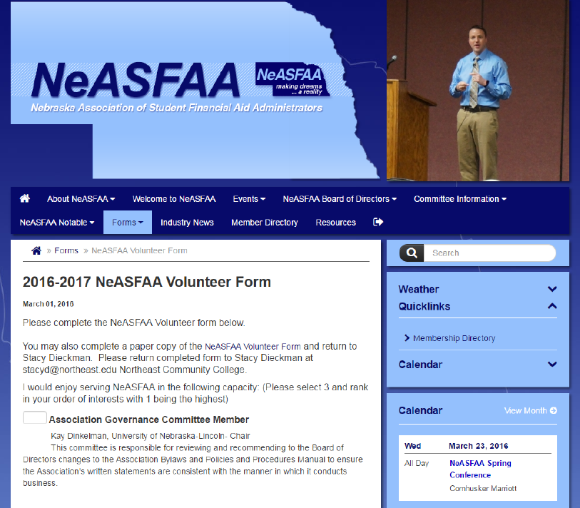
NeASFAA.org
Volunteer for NeASFAA
Committee member
Committee chair
Board member
Notes:
NeASFAA relies on volunteers to be successful! There are many ways to be involved
Committee member
Committee chair
Board member
It’s a great way to get to know your colleagues and develop as a professional.
No experience necessary

Slide 11
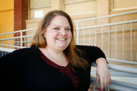
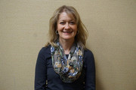
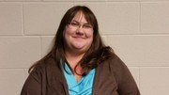
NeASFAA
Do you have questions about NeASFAA?
Becca Dobry,
Four-year Public Sector
Sheila Johns,
Two-year Public Sector
Heather Kester,
Private Career Sector
Taryn Rouse,
Four-year Private Sector
Kent Wolfe,
Associate Sector

Slide 12
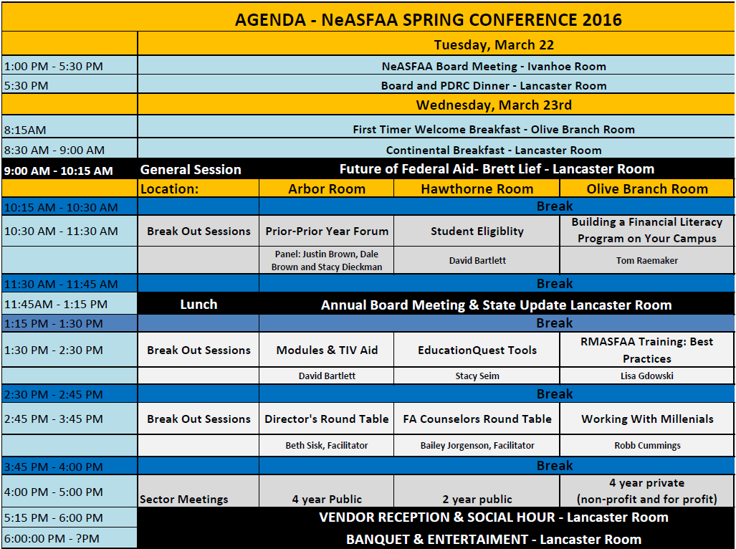
Spring Conference

Slide 13
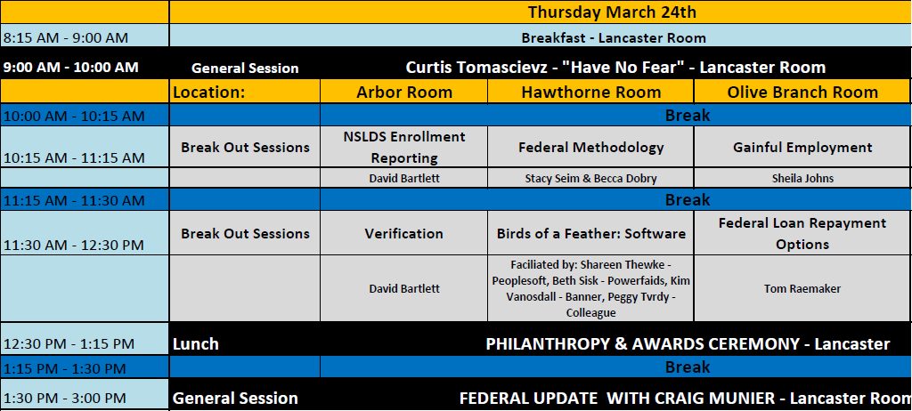
Spring Conference

